Slide 1
Algorithm Bit strings Non rec(n)
//Generates non recursively all the bit strings of a given length
//Input: A positive integer n
for i ← 0 to n − 1 do
B[i] = 0
repeat
print(B)
k ← n − 1
while k ≥ 0 and B[k] = 1
k ← k − 1
if k ≥ 0
B[k] ← 1
for i ← k +1 to n − 1 do
B[i] ← 0
until k = −1

Slide 2
Design a divide-and-conquer algorithm for generating all permutations of k items chosen from n, i.e., all k-element subsets of a given n-element set. Is your algorithm a minimal-change algorithm?
call Arrange(1,k) where
Algorithm Arrange(i,k)
{
if k=0
print A;
Else
p=n*(n-1)*(n-2)*…….*(n-k+1);
for j<-i to p
A[k]<-p;
Arrange(j+1,k-1);
}

Slide 3
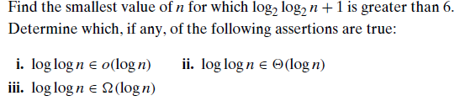

Slide 4
We can solve the inequality log2 log2 n + 1 > 6 as follows:
log2 log2 n + 1 > 6
log2 log2n > 5
log2n > 2^5
n > 2^32 (> 4 ・ 10^9).

Slide 5
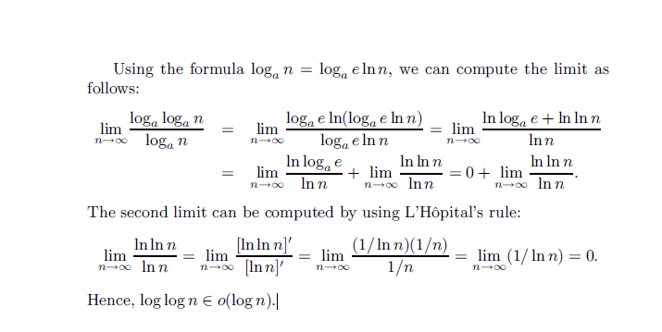

Slide 6
Let P is a quick sort program to sort numbers in ascending order using the first element as the pivot. Let t₁ and t₂ be the number of comparisons made by P for the inputs [1 2 3 4 5 6 7] and [4 7 6 1 5 3 2] respectively. Which one of the following holds?
t₁ = t₂
t₁ < t₂
t₁ > t₂
t₁ =5

Slide 7
Time complexity of the given program is : function(int n) { if (n==1) return; for (int i=1; i<=n; i++) { for (int j=1; j<=n; j++) { printf("*"); break; } } }
Ο(nlogn)
Ο(n)
Ο(1)

Slide 8
Consider the following recursive function which is used to evaluate the longest common subsequence of two strings X and Y having length m and n respectively. Find the missing statement in the code : int strmatch( char *X, char *Y, int m, int n ) { if (m == 0 || n == 0) return 0; if (X[m-1] == Y[n-1]) return 1 + strmatch(X, Y, m-1, n-1); else return _________ }
Max(strmatch(X, Y, m-1, n),strmatch(X, Y, m, n-1))
Max(strmatch(X, Y, m-1, n-1),strmatch(X, Y, m, n-1))
Min(strmatch(X, Y, m-1, n),strmatch(X, Y, m, n-1))
Min(strmatch(X, Y, m-1, n-1),strmatch(X, Y, m, n-1))

